Slide 1
FAS EXAM RESULT Mobile App
Internal Supervisor:
Prof.R.G.N.Meegama
Heshan Karunaratne
AS2014409

Slide 2
Content
Introduction
Objectives
Tools & Technologies
Progress
Methodology
Future Works
References

Slide 3
Introduction
Mobile technology has evolved rapidly over the past few years.
People use mobile applications for almost everything.
Mobile applications provide users with similar services to those accessed on Personal Computers or Laptops.
This project removes the barrier of checking results from a web-site.

Slide 4
Objectives
Check Exam Results
Check the no of Attempts taken
Check GPA
Check Rank

Slide 5
Tools & Technologies
Android Studio-Java & XML
Node js
RestFul Web Services
JSON
Retrofit

Slide 6
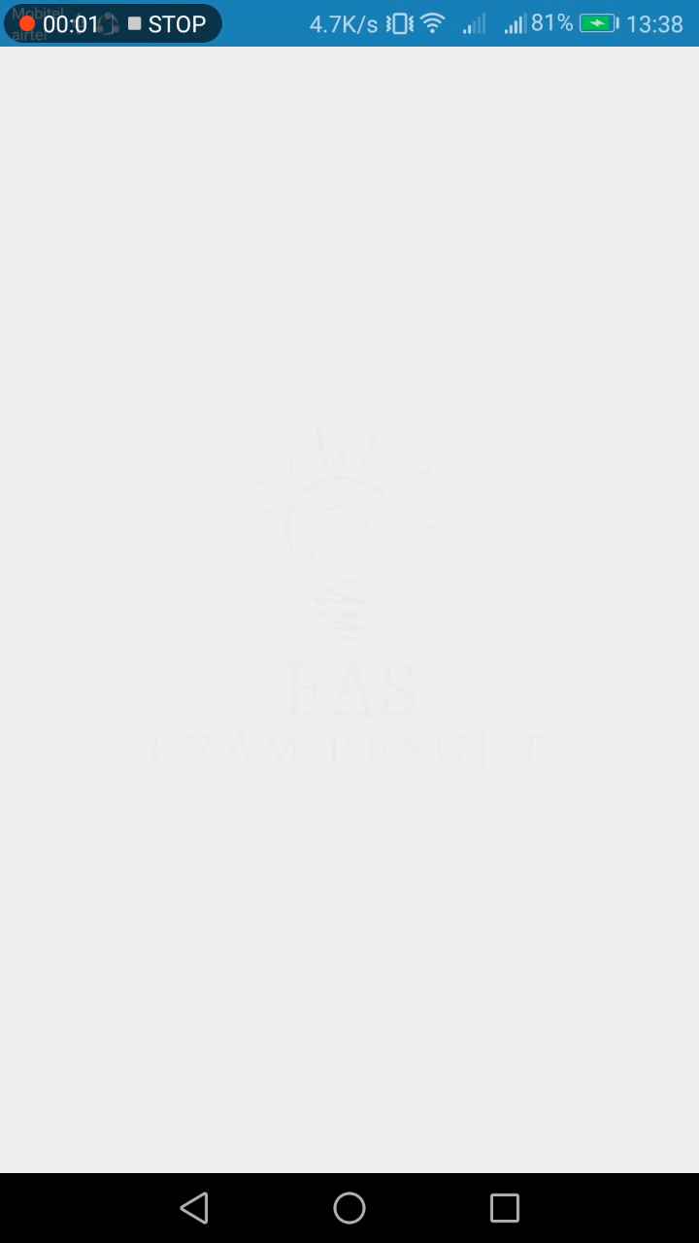
Progress

Slide 7
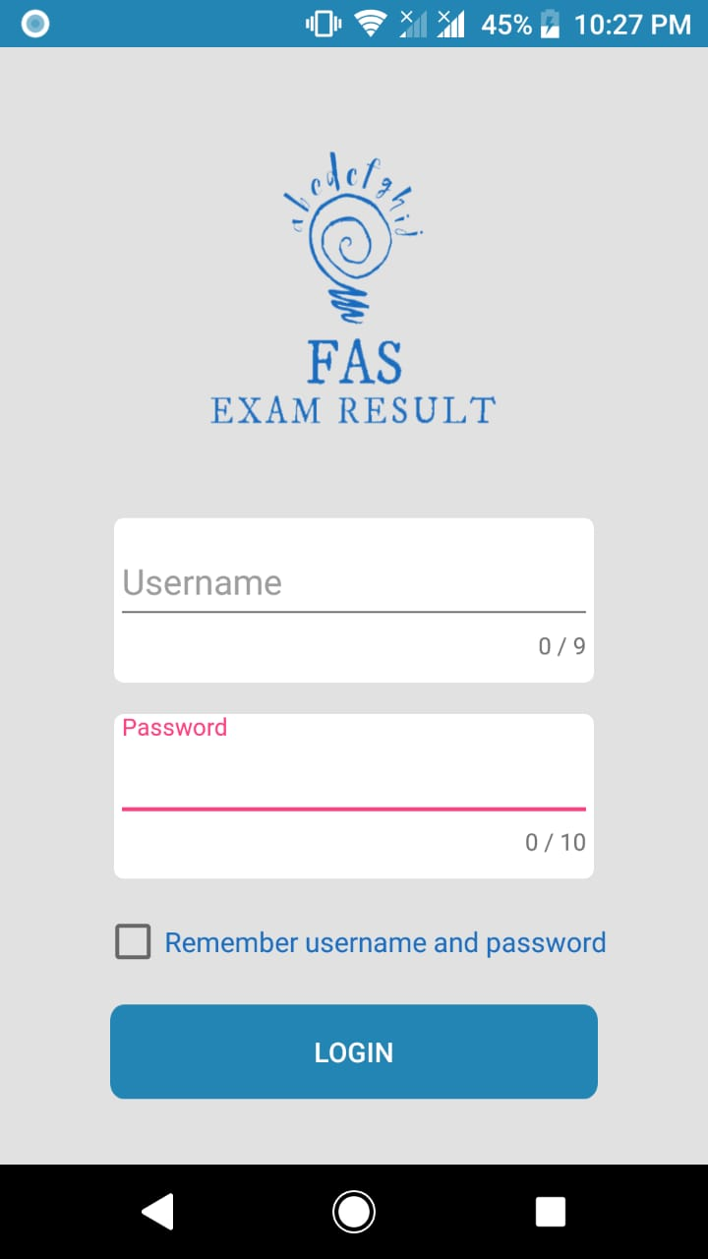
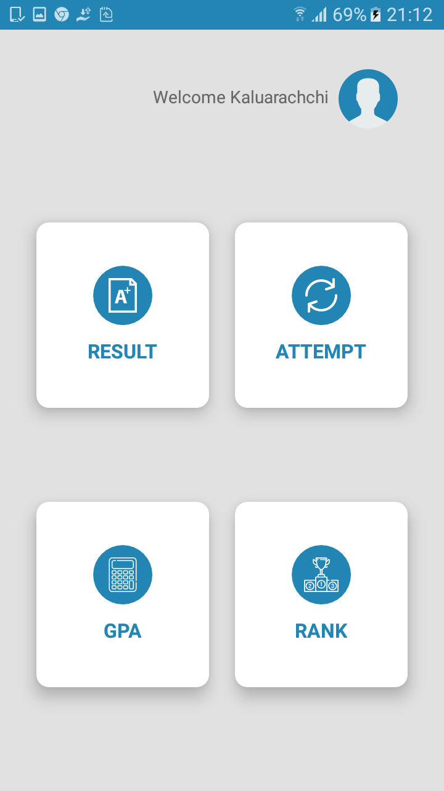
Methodology-1
Database Selection
Notes:
Login authentication to home page

Slide 8
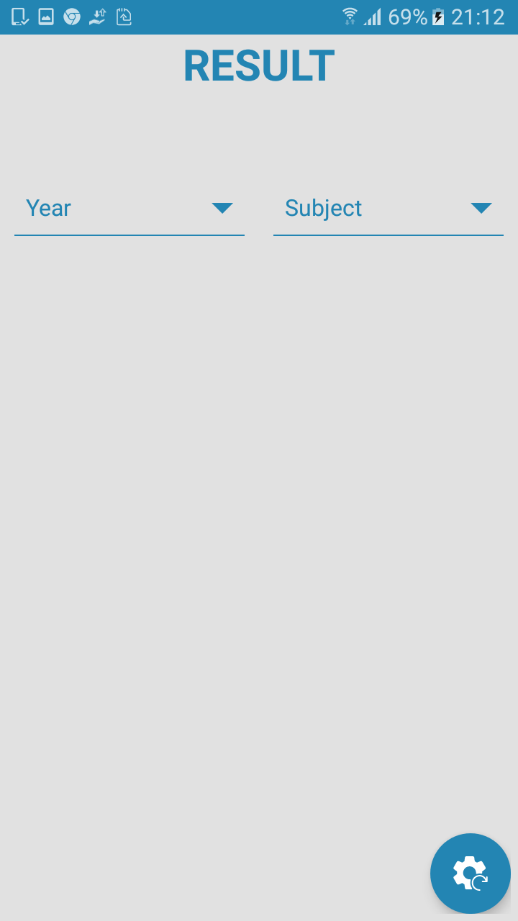
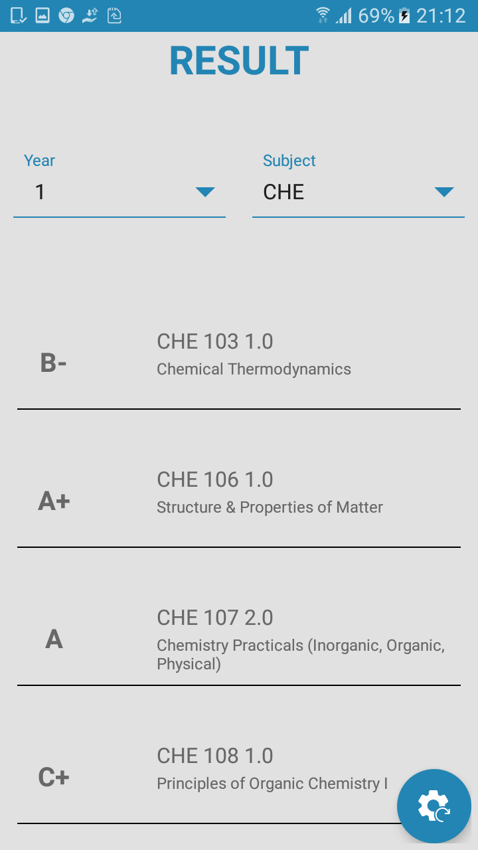
Methodology-2
Retrofit Library
RestFul Web Services
JSON
Notes:
Result activity

Slide 9
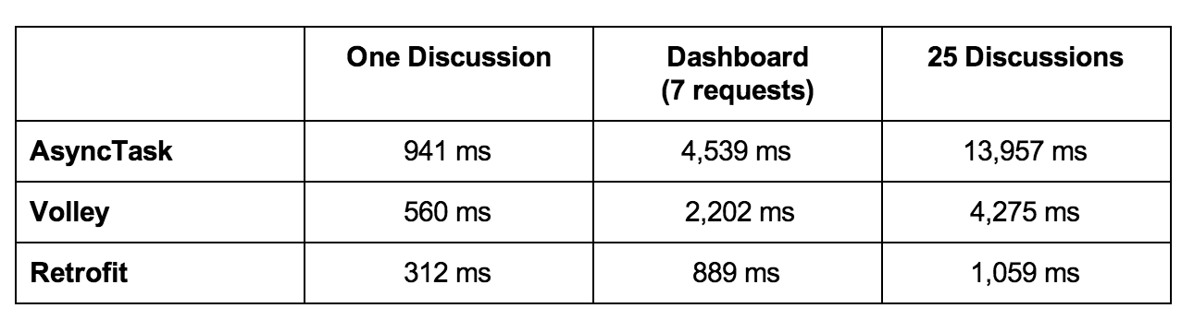
Methodology-3 Network Libraries

Slide 10
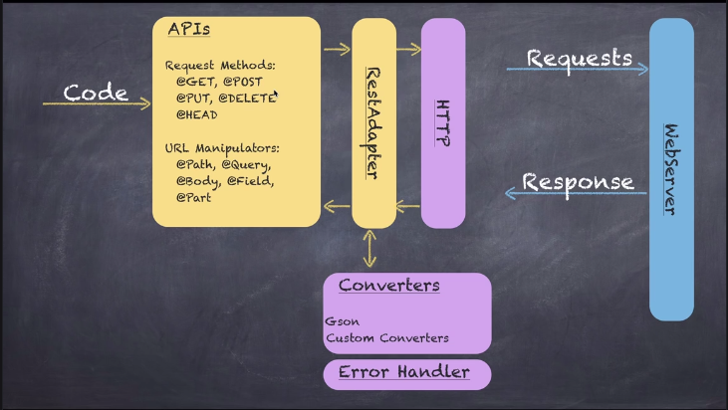
Methodology-4 Retrofit
A type-safe REST client for Android and Java
Retrofit consist,
Rest Adapter-Base URL
Api Interface-Async and Sync
Model Class – Getters and Setters
REST
Representational State Transfer
GET,POST,PUT,DELETE Operations
Eg: 192.210.160.177:4001/login/{username}/{password} 192.210.160.177:4001/getAttempts/subject/{GetSubject}/year/{GetYear}

Slide 11
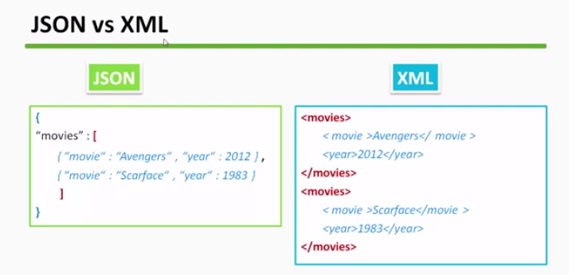
Methodology-5 JSON
JavaScript Object Notation
Advantages
Lightweight
Language independent

Slide 12
Future Works
IOS based mobile app

Slide 13
REFERENCES
Retrofit
https://www.youtube.com/playlist?list=PLshdtb5UWjSoFPs3AakEpH1pmSrJVxJhs
Tutorials
https://www.tutorialspoint.com/android/
Android app development for beginners
https://www.youtube.com/playlist?list=PL6gx4Cwl9DGBsvRxJJOzG4r4k_zLKrnxl

Slide 14
Thank You!

